Slide 1




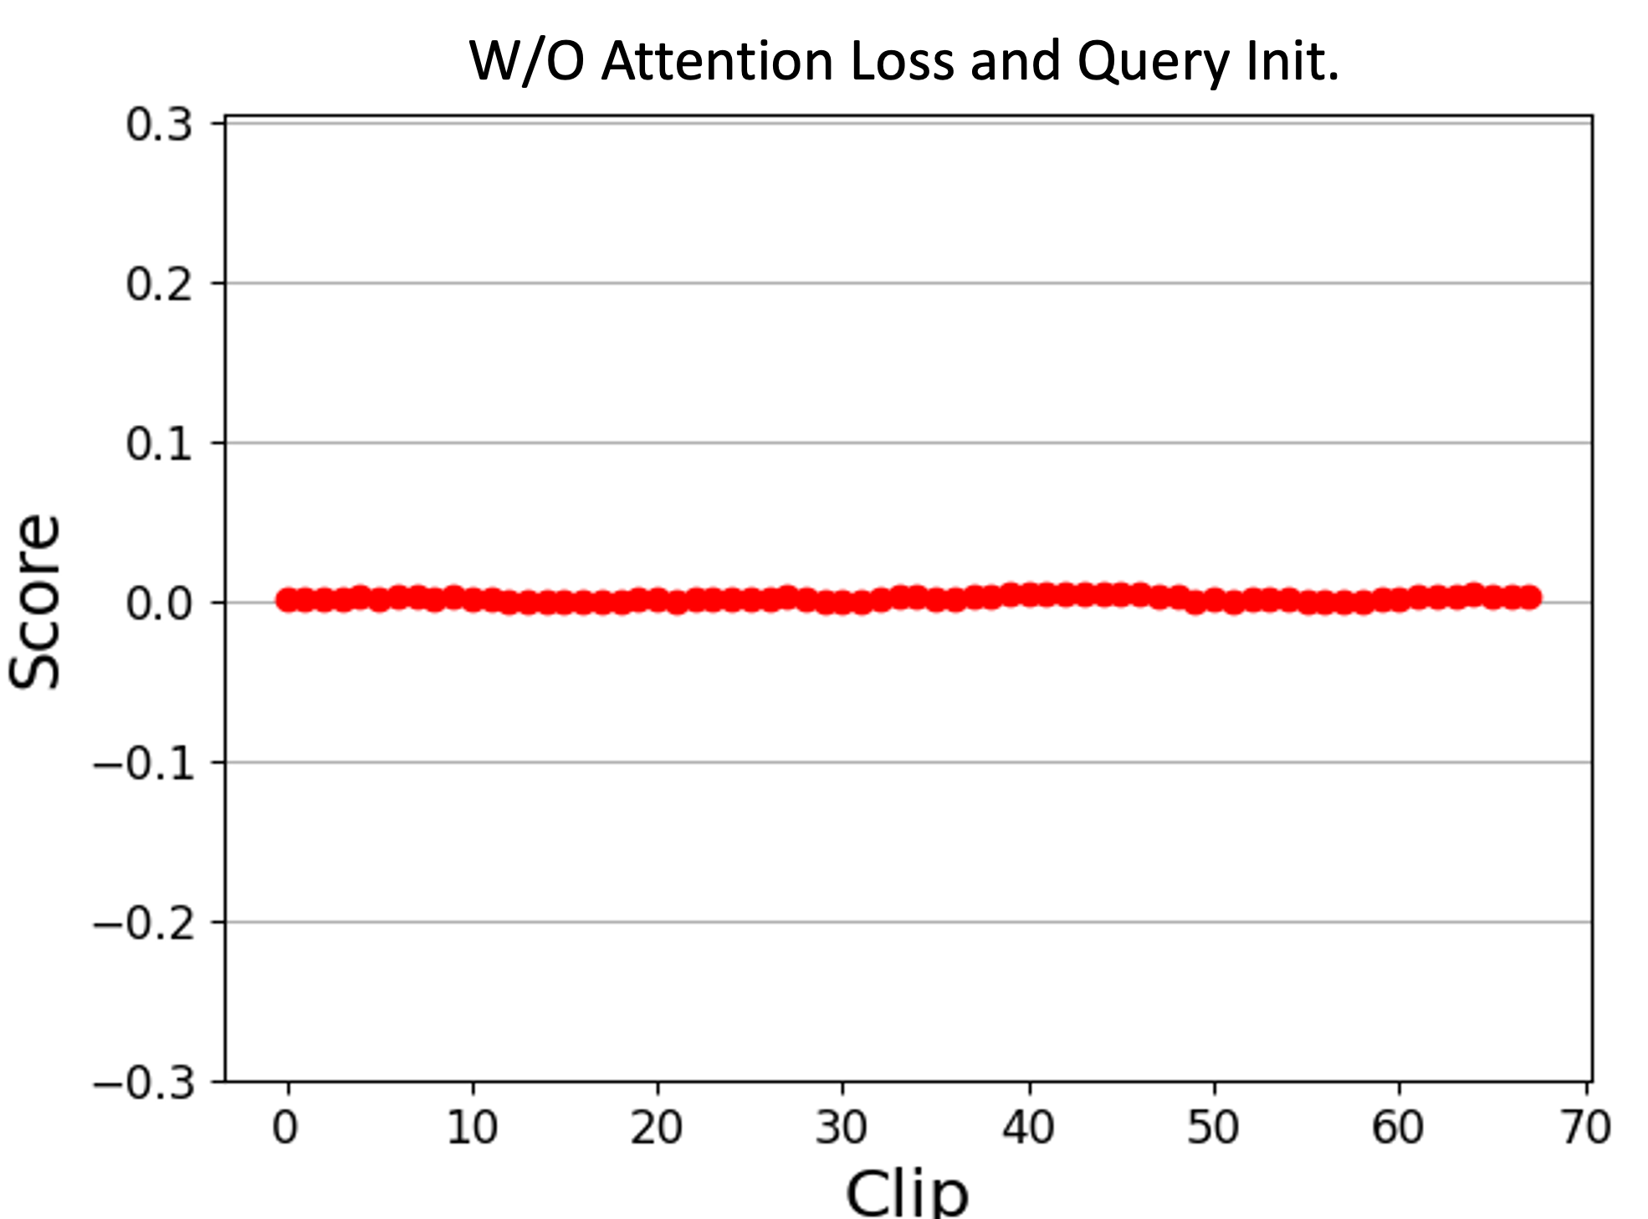
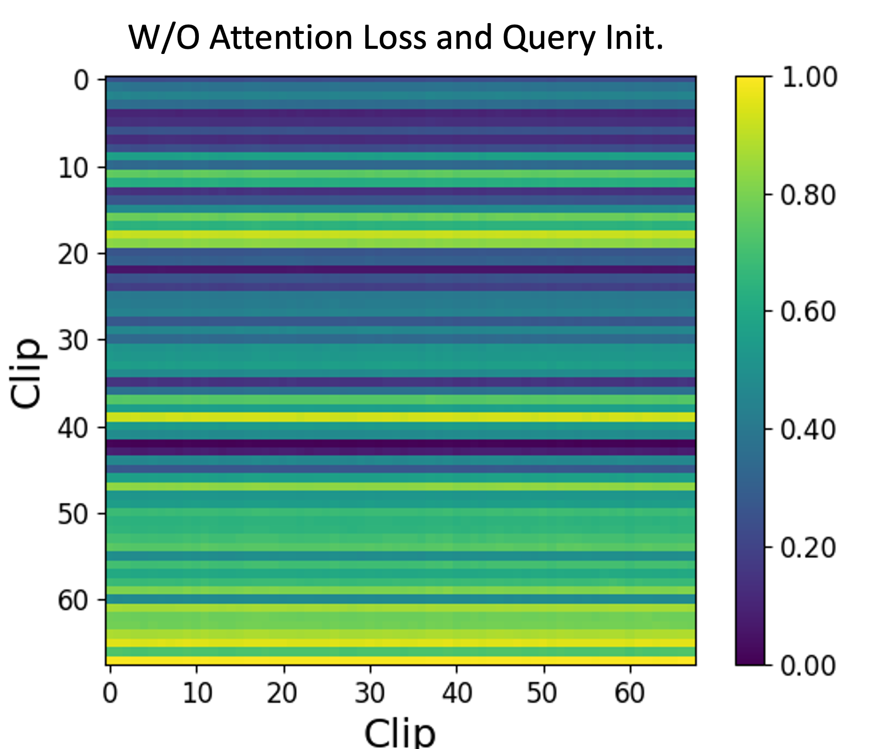
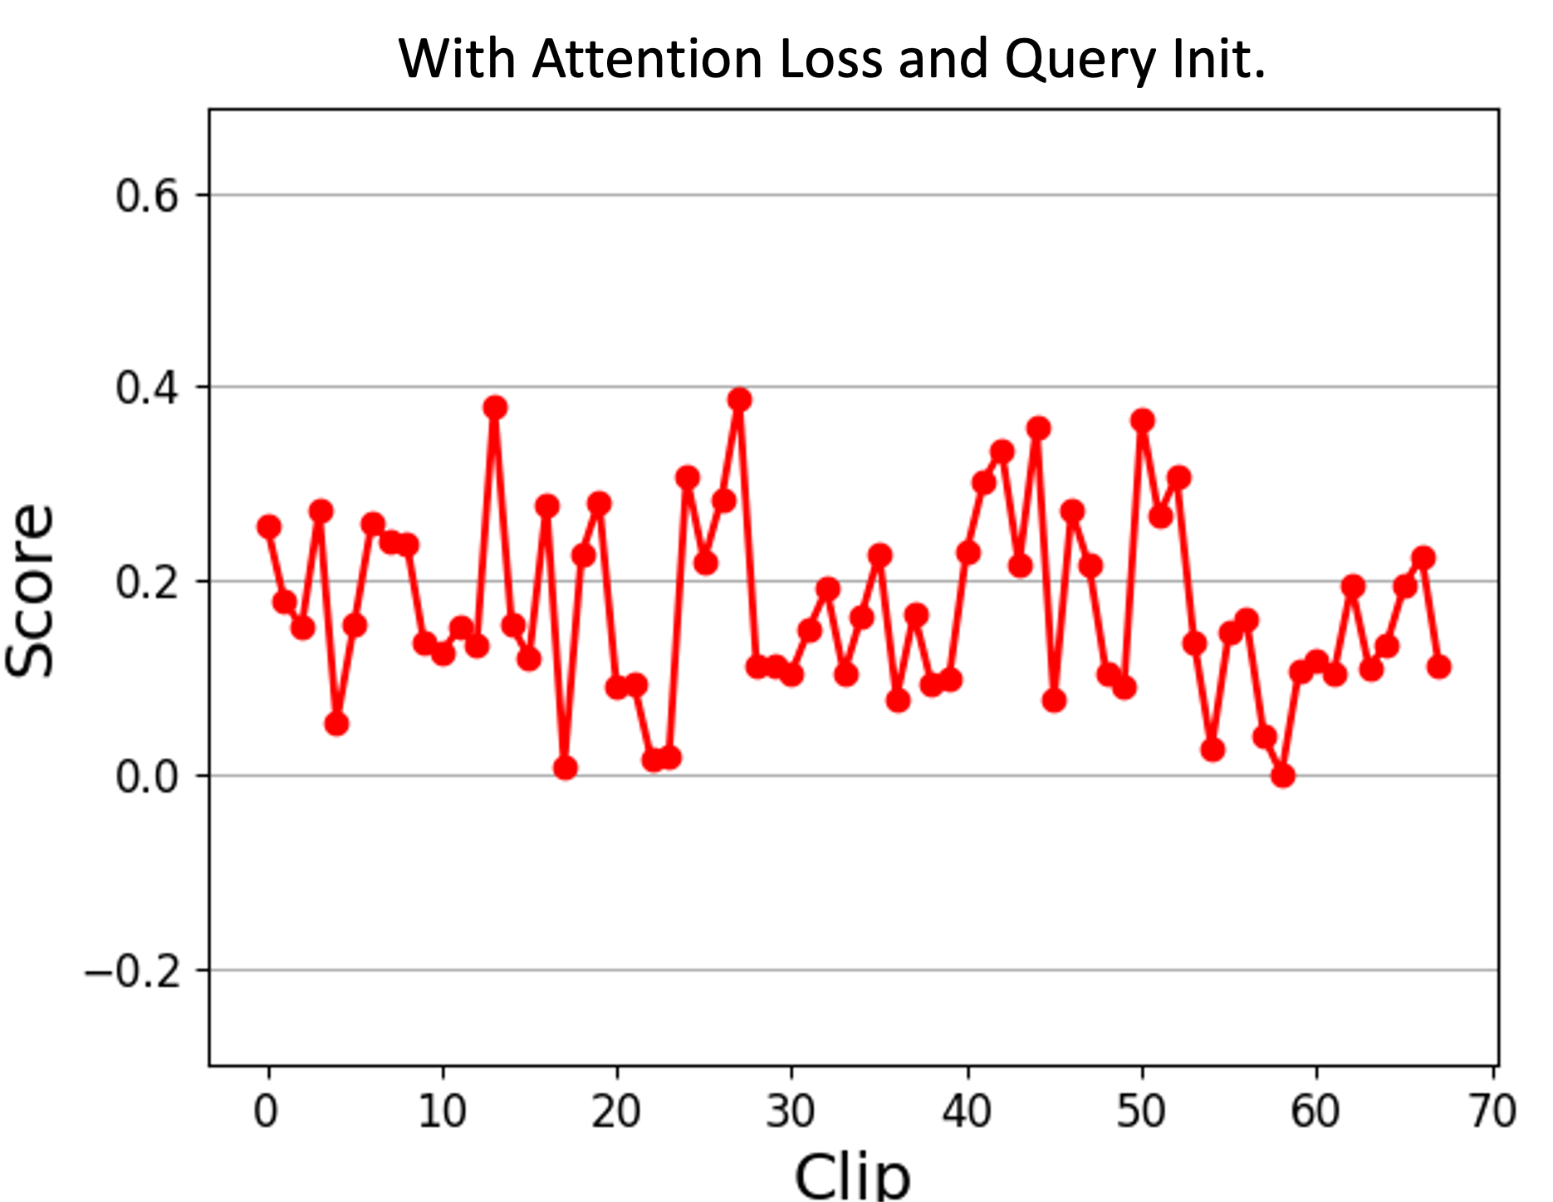
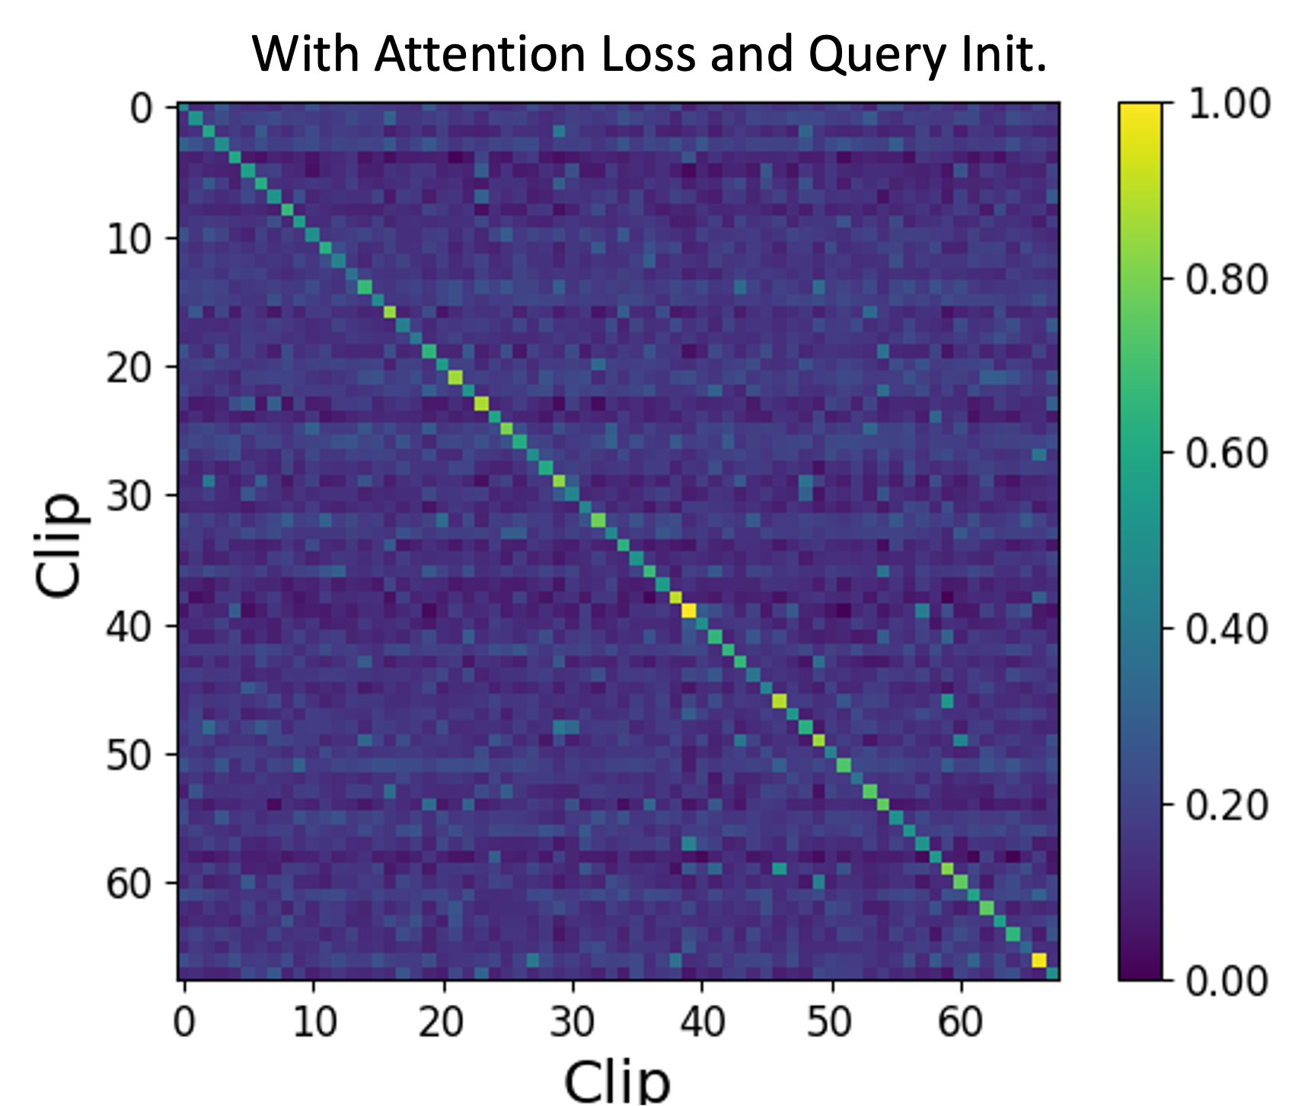
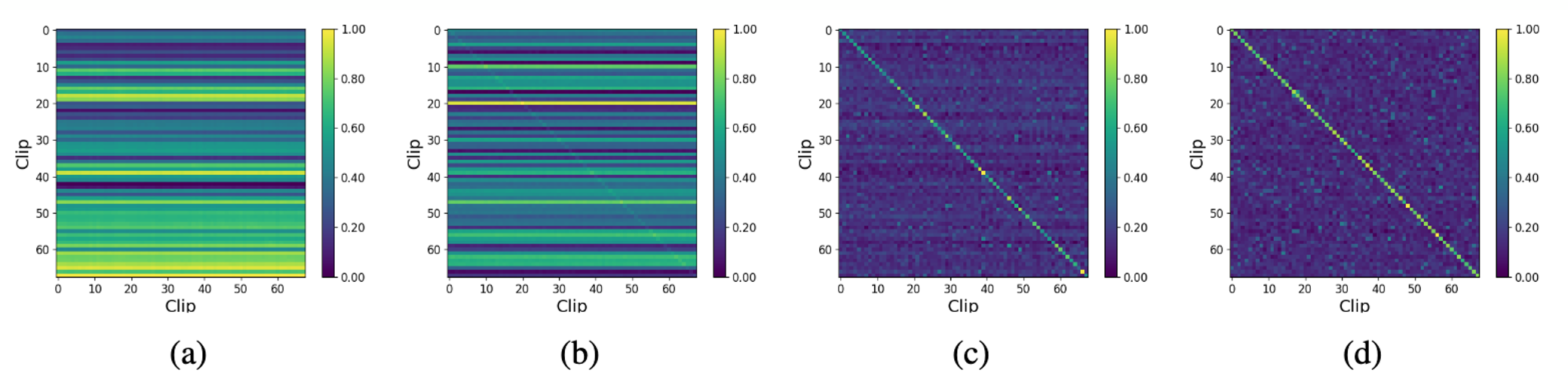
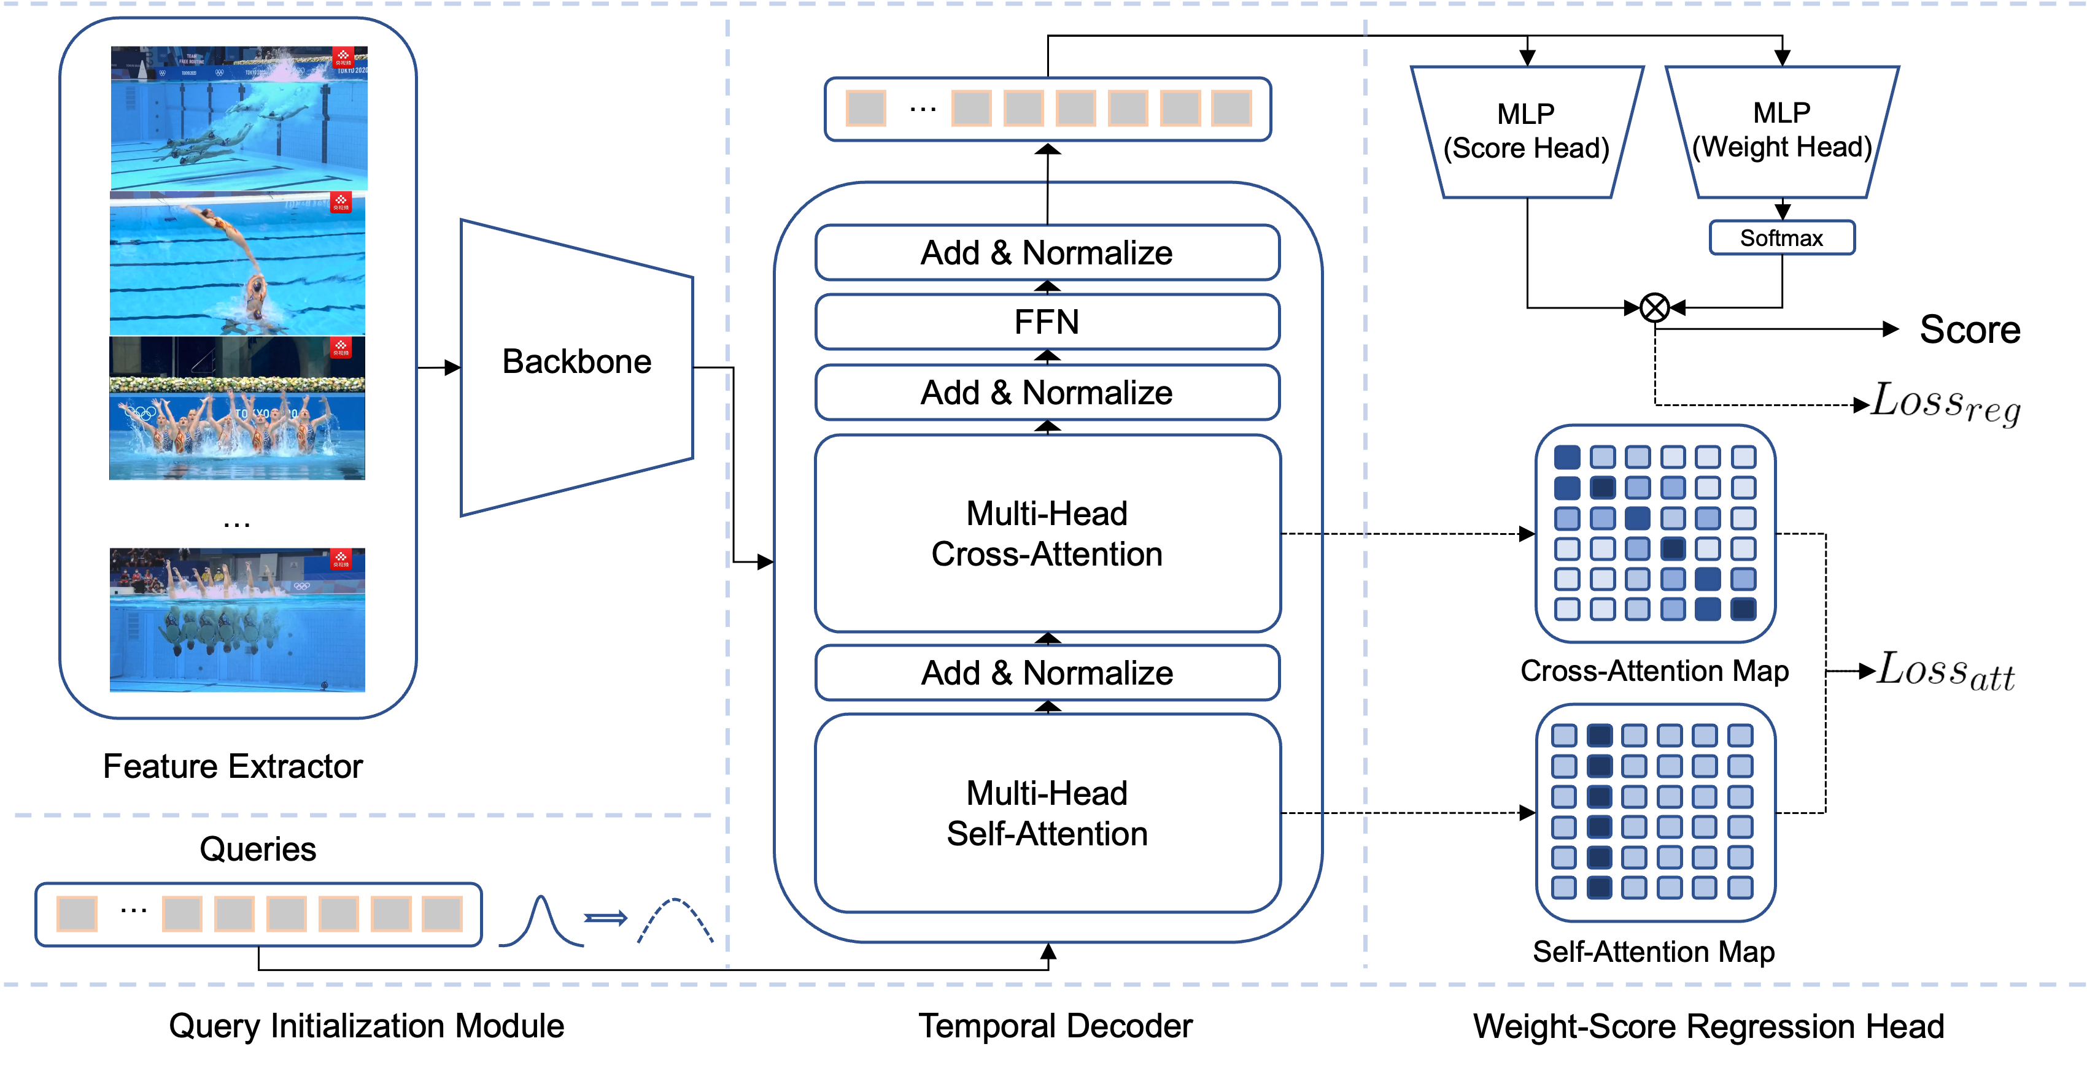
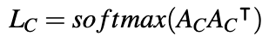
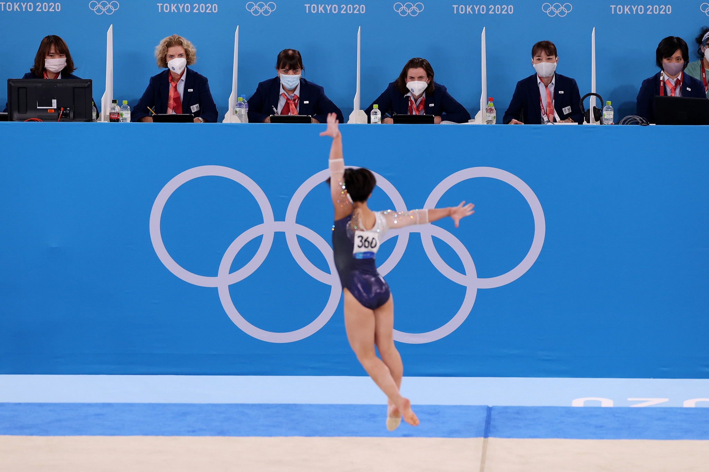
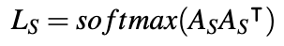
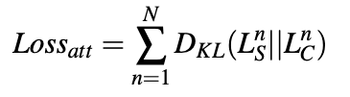
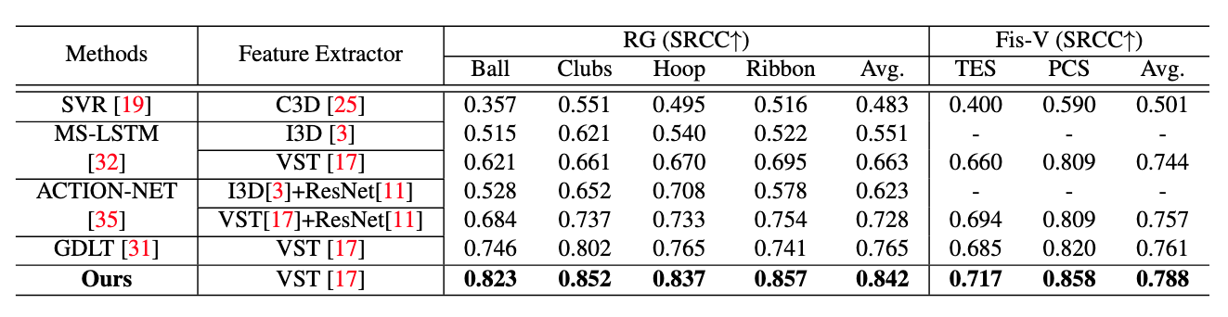
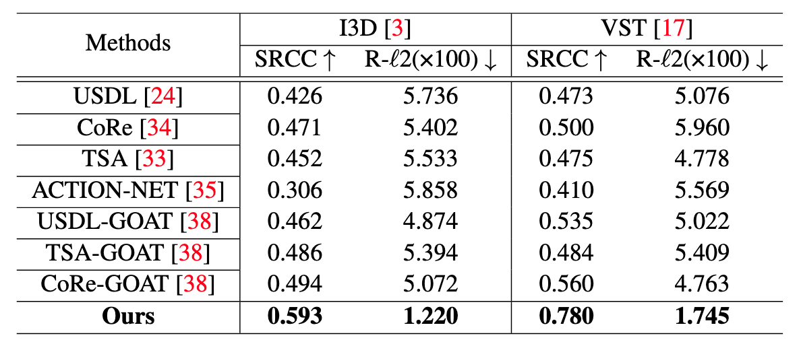
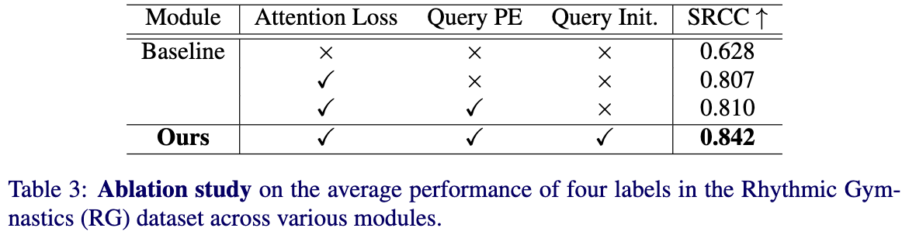
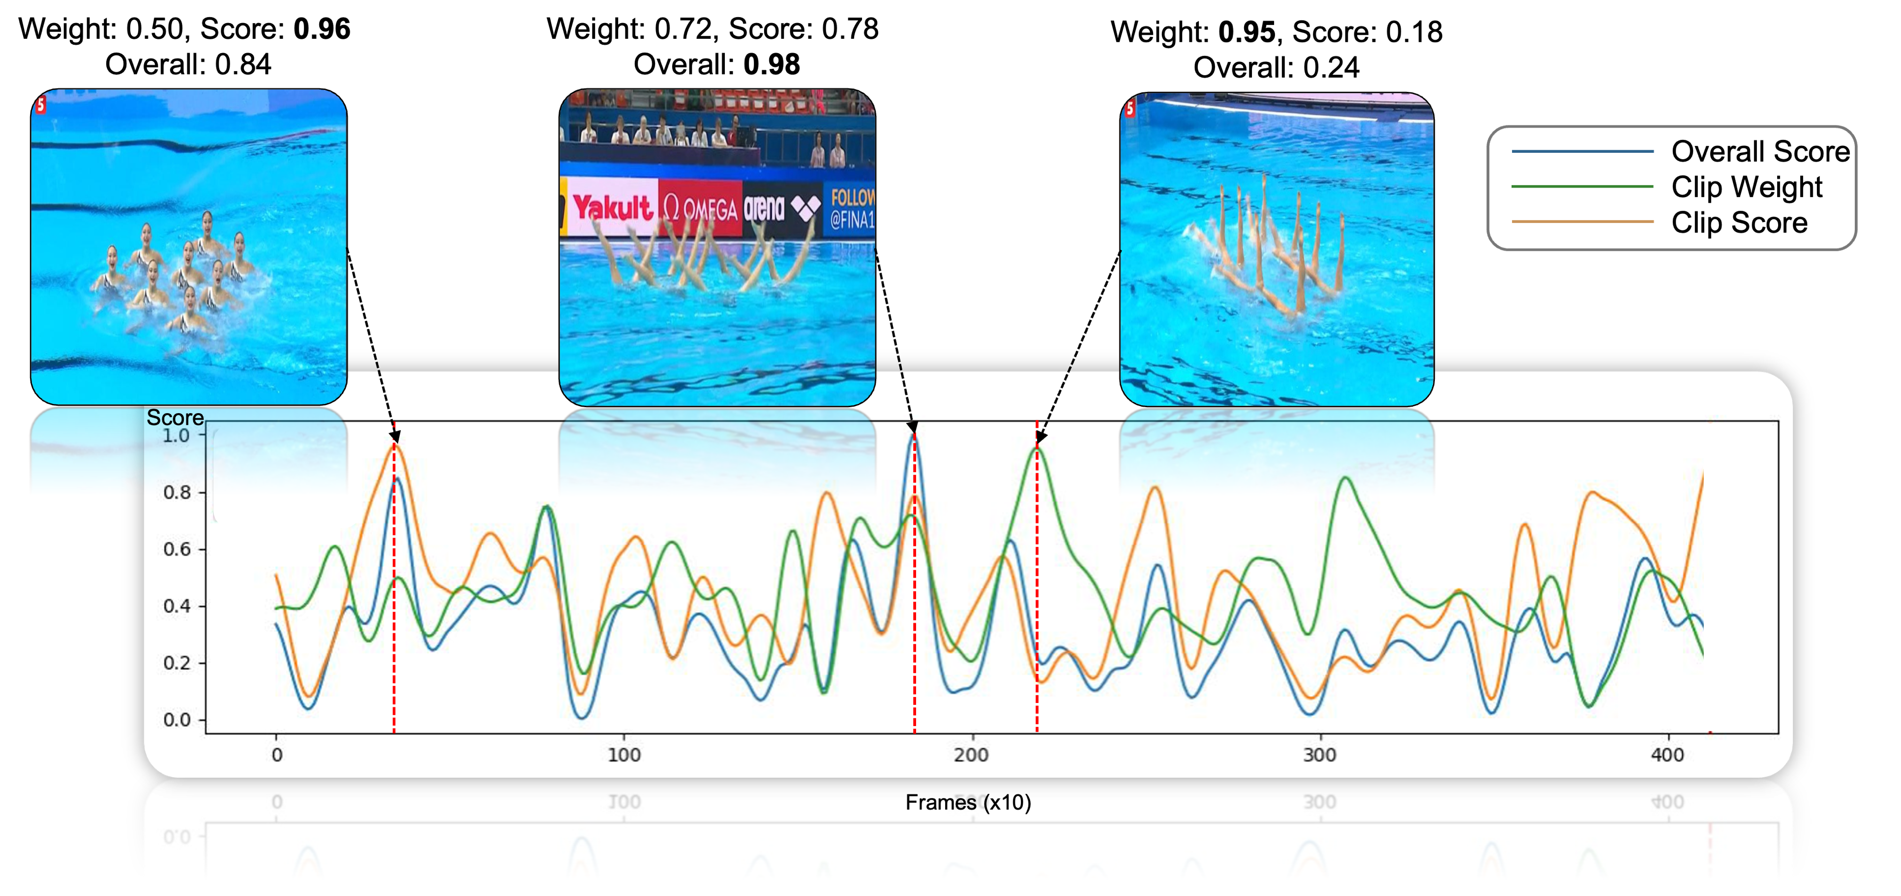
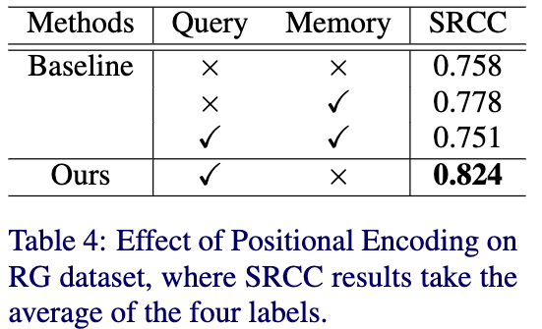
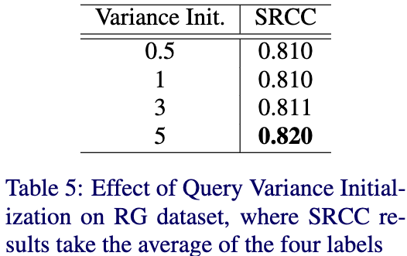
Interpretable Long-term Action Quality Assessment Xu Dong, Xinran Liu, Wanqing Li, Anthony Adeyemi-Ejeye, Andrew Gilbert Github Page: https://github.com/dx199771/Interpretability-AQA
Scan To Read
TL;DR
Temporal Skipping Problem
AQA: Evaluate how well an action is performed in a video.
Problem1: Limited Understanding of Long Temporal Sequences.
Problem2: Existing AQA models regress single score and lack interpretability.
Solution: Develop an interpretable AQA network with the ability to handle long-term videos.
Temporal sequences lead the model to select shortcuts and skip decoder self-attention, thus preventing output degradation.
Methodology
Query Initialization Module
Temporal Decoder: Transformer based decoder uses learnable clip queries as input with semantic meaning to learn clip score.
Attention Loss: Using KL divergence to constrain Self-attention and Cross-attention outputs and eliminate Temporal Skipping Problem.
Query Init: Using different variance to initialize query boost performance.
Two Head Regression: Weight-Score regression head provides interpretability to the network.
Using different variance to initialize the query embedding can improve the query correlation of self-attention map.
Using larger variance outperforms lower variance.
Our Pipeline
Weight-Score regression head
Decoupling the output the decoder into weight and score branches to align with the scoring logic of human judges in the real world.
Quality
(Score)?
Difficulty
(Weight)?
Experiment
Results
Performance comparison on Rhythmic Gymnastics (RG) and Figure Skating Video (Fis-V) dataset
Performance comparison on LOGO dataset
Ablation Studies
Visualization of clip-level weight-score regression

